Slide 1
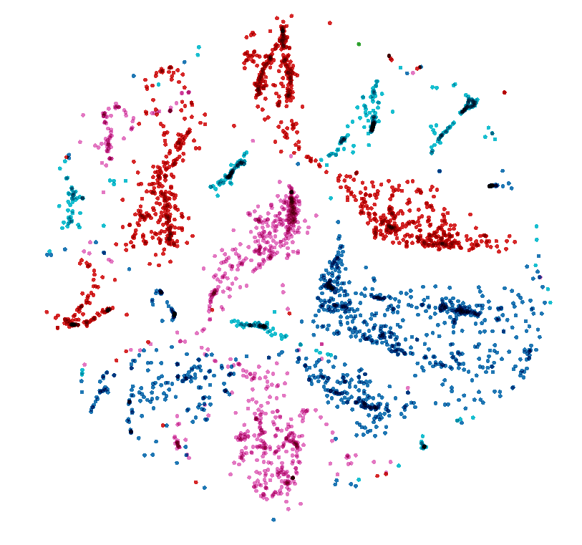
Raj Sarode
SVM
Data Science Engineering Methods and Tools

Slide 2
INTRODUCTION
Support vector machines so called as SVM is a supervised learning algorithm which can be used for classification and regression problems as support vector classification (SVC) and support vector regression (SVR).
It is used for smaller dataset as it takes too long to process. In this set, we will be focusing on SVC.

Slide 3
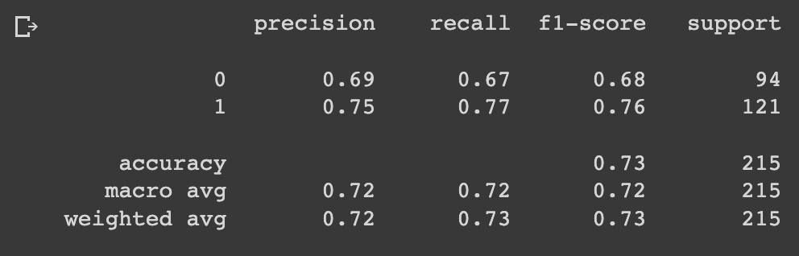
Linear Kernel
Linear Kernel is used when the data is Linearly separable, that is, it can be separated using a single Line. It is one of the most common kernels to be used.
It is mostly used when there are a Large number of Features in a particular Data Set. One of the examples where there are a lot of features, is Text Classification, as each alphabet is a new feature.
So, we mostly use Linear Kernel in Text Classification.

Slide 4
Polynomial Kernel
A polynomial kernel is a kind of SVM kernel that uses a polynomial function to map the data into a higher-dimensional space.
It does this by taking the dot product of the data points in the original space and the polynomial function in the new space.
In a polynomial kernel for SVM, the data is mapped into a higher-dimensional space using a polynomial function.
The dot product of the data points in the original space and the polynomial function in the new space is then taken.

Slide 5
Polynomial Kernel
RBF short for Radial Basis Function Kernel is a very powerful kernel used in SVM. Unlike linear or polynomial kernels, RBF is more complex and efficient at the same time that it can combine multiple polynomial kernels multiple times of different degrees to project the non-linearly separable data into higher dimensional space so that it can be separable using a hyperplane.
RBF kernel can be able to solve most of the overlapped datasets (just like above). However, you don't need to think that RBF kernel can be used to solve almost any given dataset of different distributions.
In some cases, the RBF kernel will not be good for some kinds of datasets, so there we can try other kernel functions.

Slide 6
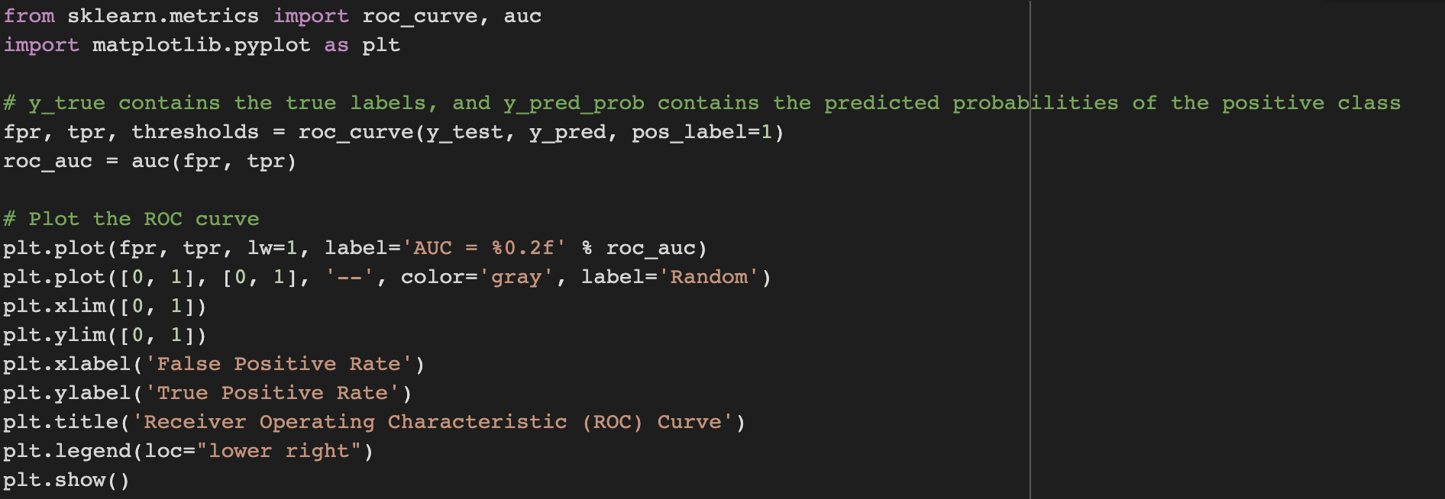
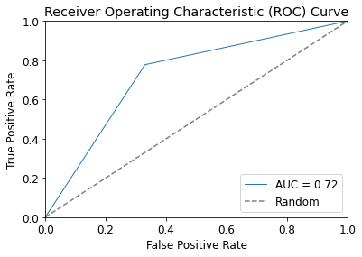
Results for ROC CURVE

